Slide 1

EJADA EAI
Database Center of Excellence

Slide 2
Agenda
Database Design and Development Process
DB Application Lifecycle
Single Program Lifecycle
Don’t Jump to Code (Program Preparation)
Exception handling
Testing, Tracing, and Debugging
Code Generation
DB Team Standards and Best Practices
Naming Conventions (standards)
PL/SQL good news
PL/SQL Best Practices (selected topics)
Continuous Improvement

Slide 3
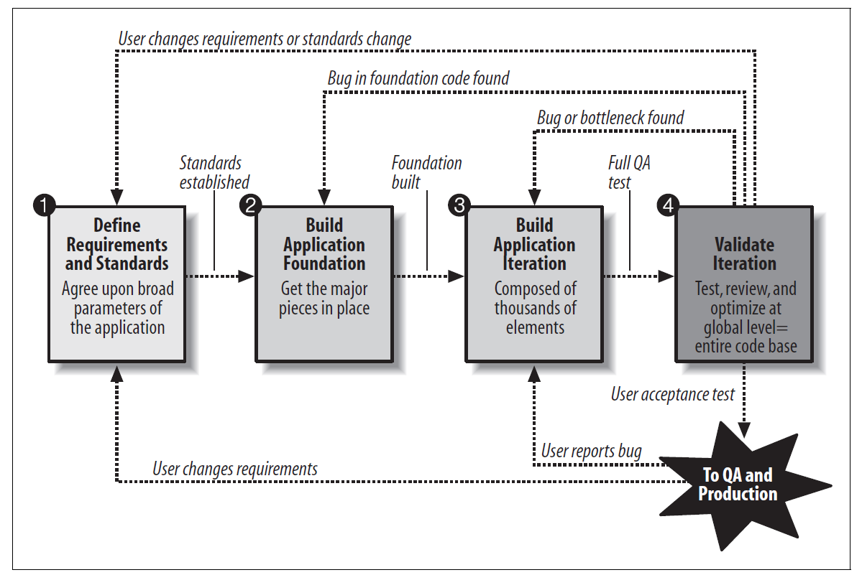
Recommended workflow for the entire application

Slide 4
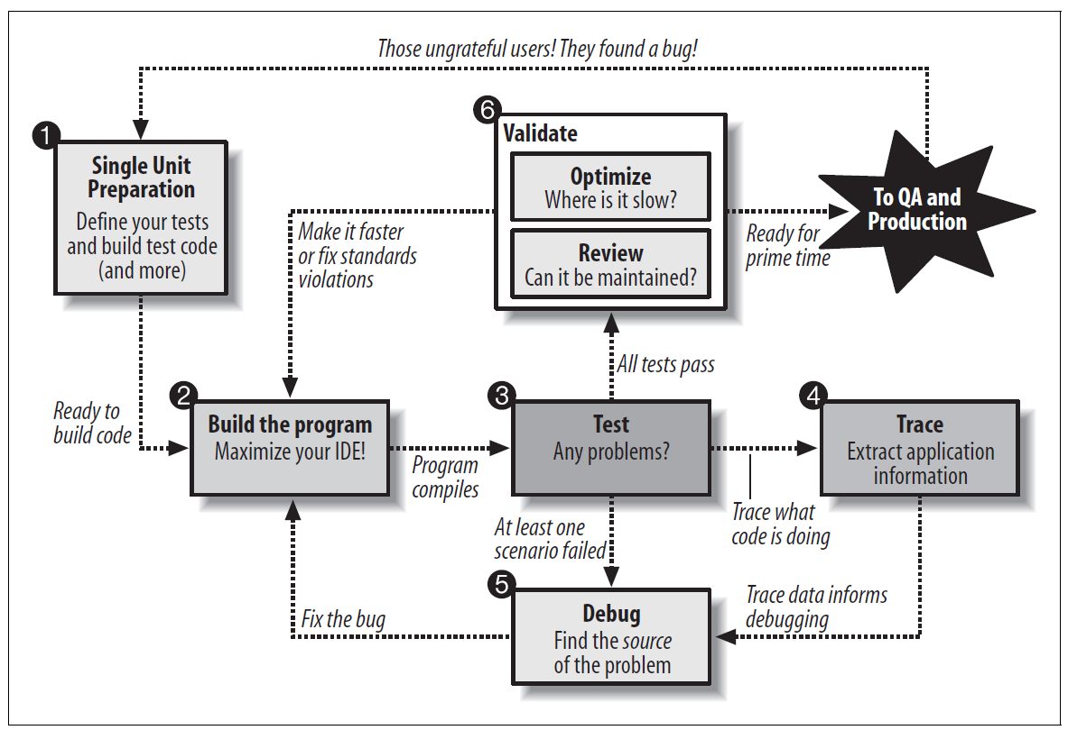
Workflow for each program you build

Slide 5
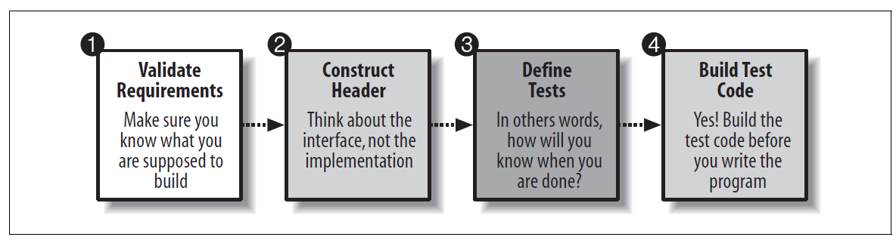
Four Steps for preparing an application

Slide 6
DB Program Contract
Functional Requirements
Description
Parameters
IN/OUT/INOUT
Names
Data Types*
Allowable Values and their meaning
By reference or by value
Return Value
Type
Allowable values and their meaning
Exceptions and Error Codes
Non-Functional Requirements
Expected Call Rate
Expected Data Volume
Synch/Asynch
Interactive (online) / Batch
Required response time
Parallel Execution and Concurrency
* For data types use <TABLE_NAME>.<COLUMN_NAME>%TYPE or SUBTYPES rather than hard-coded lengths

Slide 7
Database Design Considerations
Involve the DBA from design phase (physical DB Design)
Indexes (B+ tree, bitmap, …)
Partitioning
Clustering and Index-organized tables
Column-organized tables
...

Slide 8
Version Control
Liquibase
Open-source extensible Tool for DB Version Control
Migration-based (not state-based)
Initially for Schema and Lookup Data (REF Data)
Can automate stored procedure VC by customization (future)
TFS
GIT repo in TFS for DB objects
Includes stored procedure logic and schema/REF data updates
Updates in SP, Schema, REF Data must be linked to tasks in TFS

Slide 9
DB Program Test Cases
Testing
Test for success (happy scenarios)
Test boundary conditions (maximum and minimum expected values)
Test for Exceptions (expected and unexpected exceptions)
Test for performance
Throughput
Response Time

Slide 10
Unit Testing (utPLSQL)
Auto Testing using utPLSQL
Best Open-source unit testing package for PL/SQL
Includes many assertion features out of the box
Automatic rollback of all test data (sandbox)
Can be run from SQL Developer, command Line, Maven …
Can be integrated with DevOps pipelines

Slide 11
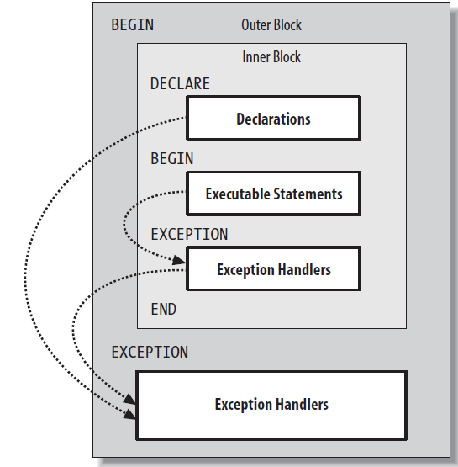
Exception Handling Guidelines
Study how error raising, handling, and logging work in PL/SQL
Distinguish between deliberate, unfortunate, and unexpected errors.
Decide on the standard ways that you will write code to respond to these different errors.
Avoid application logic in the exception section.
Transform the exception to a status indicator that can be interpreted by the user of that code.
Handle those unexpected, “hard” errors and then re-raise the exception.
How do I log my error? Develop and use a single component (which will usually consist of a central package or two, plus one or more supporting tables) that does most of the work
Use the EXCEPTION_INIT pragma to name exceptions and make your code more accessible.

Slide 12
All exceptions are not created equal
Deliberate
The code architecture itself deliberately relies upon an exception in the way it works. This means you must (well, should) anticipate and code for this exception. An example is UTL_FILE.GET_LINE.
Unfortunate
This is an error, but one that is to be expected and one that may not even indicate that a problem has occurred. An example is a SELECT INTO statement that raises NO_DATA_FOUND.
Unexpected
This is a “hard” error indicating a problem in the application. An example is a SELECT INTO statement that is supposed to return a row for a given primary key, but instead raises TOO_MANY ROWS.

Slide 13
Life After Compilation (Test, Trace, Debug)
Testing
to verify the functionality of the program
the more you can automate the testing process the better
You then need to figure out which lines of code are causing that problem
Tracing
Used to narrow the scope of the problem (before going to Debugging)
Avoid direct calls to DBMS_OUTPUT.PUT_LINE
There are much better options to choose from (open-source packages)
Debugging
Better to utilize a full-fledged IDE
Don’t forget to add test case for the found bug!

Slide 14
Code Generation
Quick SQL
Included in Oracle APEX and Live SQL
Hundreds of standardized error-free lines of code (SQL & PL/SQL) from a handful lines of code
oddgen.org
Dictionary-driven PL/SQL code Generation
Extensible
Has a SQL Developer Plugin
PL/SQL TAPI (Table API’s) Generators
We will study the best available options and use them as a starting point to our generator.
Our generator will embed our standards (uTesting, Tracing, Comments, Exception Handling, Naming conventions, …)
Our generator Can generate PL/SQL, TSQL, PGPlsql, …

Slide 15
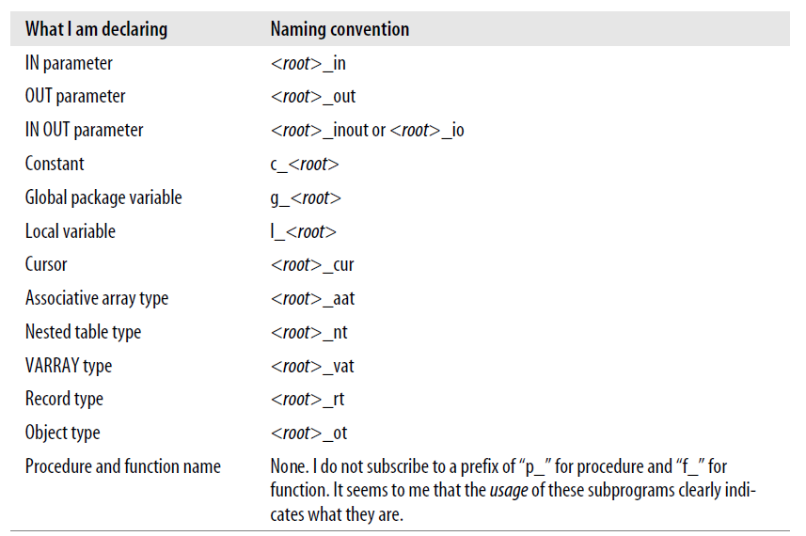
Naming Conventions (Real Developers follow standards)

Slide 16
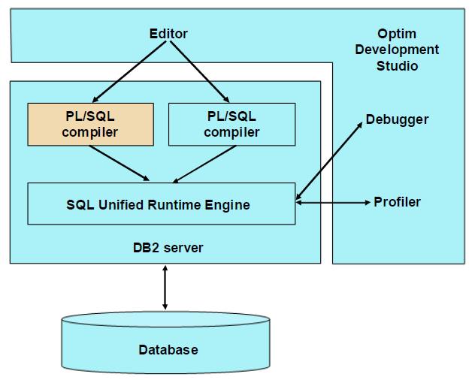
PL/SQL in DB2 ☺
DB2 introduced native PL/SQL support
DB2 engine now includes a PL/SQL compiler with the SQL PL compiler
Both compilers produce virtual machine code for DB2 SQL Unified Runtime Engine
Database Tools (Debugger, Profiler …) are hooked into DB2 at the runtime engine level
The integration of PL/SQL into DB2 as a first class procedural language has
several implications:
There is no translation. The source code remains as it is in the schema catalog
Developers can continue working in the language with which they are familiar. There is no need to translate logic to DB2 dialect even if new logic is written in SQL PL. Routines using different dialects can call each other
Packaged application vendors can use one source code against both Oracle and DB2
Both PL/SQL and SQL PL produce the same virtual machine code for the DB2 SQL Unified Runtime Engine. Therefore, by design, both PL/SQL and SQL PL perform at the same speed.
Because the debugger infrastructure hooks directly into the SQL Unified Runtime Engine, PL/SQL is naturally supported by IBM Data Studio
DB2 PL/SQL Support (reference)

Slide 17
Suggested Approach (for using PL/SQL in DB2)
Use PL/SQL for all our standard features (common core like EAIR, NE, SDR …).
Compile, test, and optimize on both DB2 and Oracle (preferably DB2 first)
If a needed feature is implemented differently (or poorly performing) in DB2 than Oracle, we should have a separate procedure for it with 2 versions (one in PL/SQL and one in SQL PL)
For project-specific business logic, we will prefer PL/SQL unless it is forced by customer to use SQL PL.

Slide 18
Analyze the following PL/SQL Examples

Slide 19

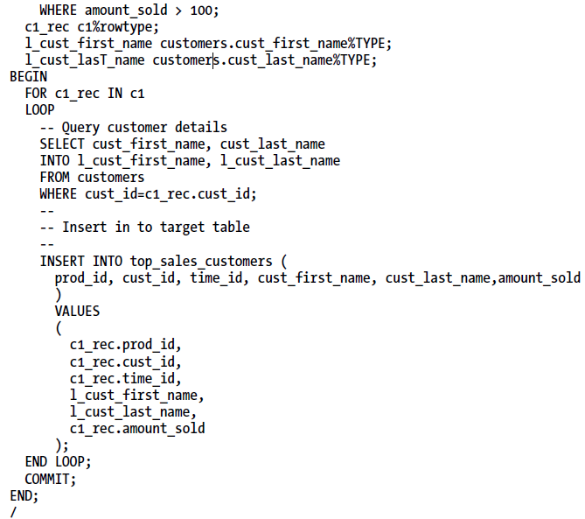
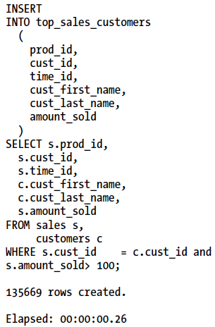
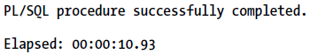
Avoid Row-by-Row Processing
This type of loop-based processing construct is highly discouraged as it leads to non-scalable code
If SELECT takes 0.1 sec, INSERT takes 0.1 sec → 5.5 h for 100,000 rows
Context switches increase elapsed time of your programs and introduce unnecessary CPU overhead
Tom Kyte (AskTom) termed this type of processing as slow-by-slow processing

Slide 20
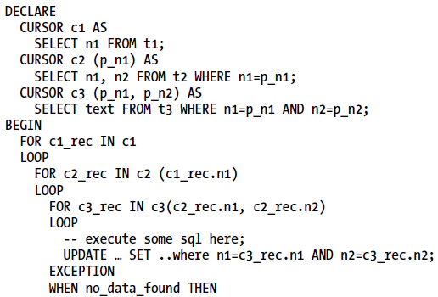
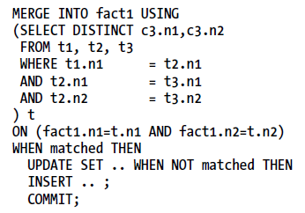
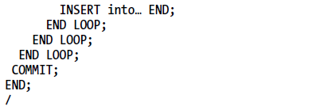
Avoid Nested Row-by-Row Processing
This type of nested loop-based processing construct is highly discouraged as it leads to non-scalable code
if the UPDATE statement is optimized to execute in 0.01 seconds, performance of the program suffers due to the deeply nested cursor. Say that cursors c1, c2, and c3 retrieve 20, 50, and 100 rows, respectively. The code then loops through 100,000 rows, and the total elapsed time of the program exceeds 1,000 seconds.
Context switches increase elapsed time of your programs and introduce unnecessary CPU overhead
The MERGE statement was introduced in DB2 V8.1 FP1
What if the logic is too complex to replace with SQL?
→ Use Collections as a scratchpad then bulk DML

Slide 21
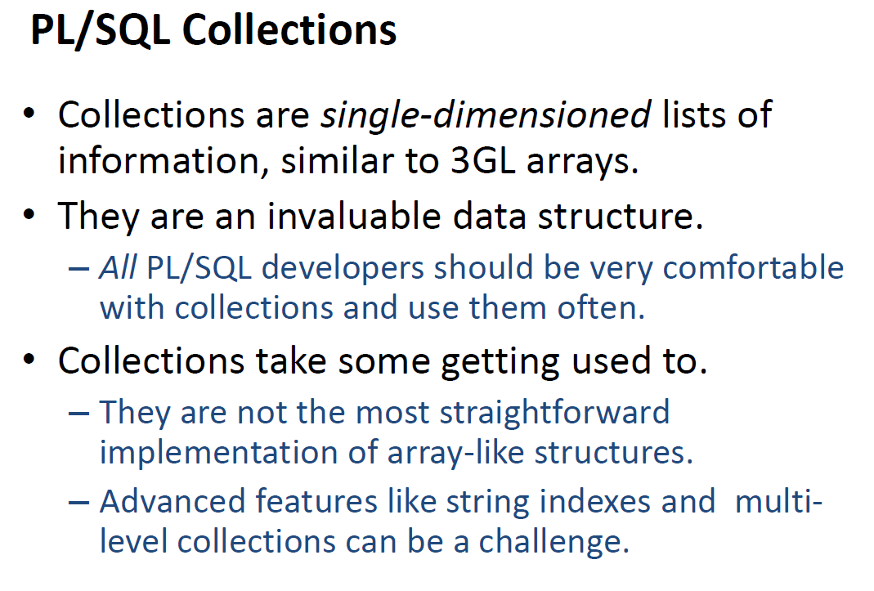

Slide 22
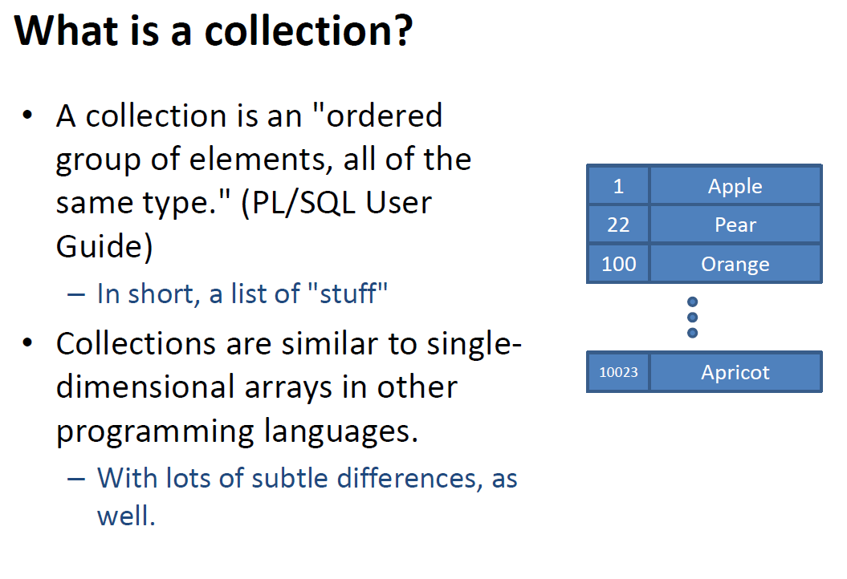

Slide 23
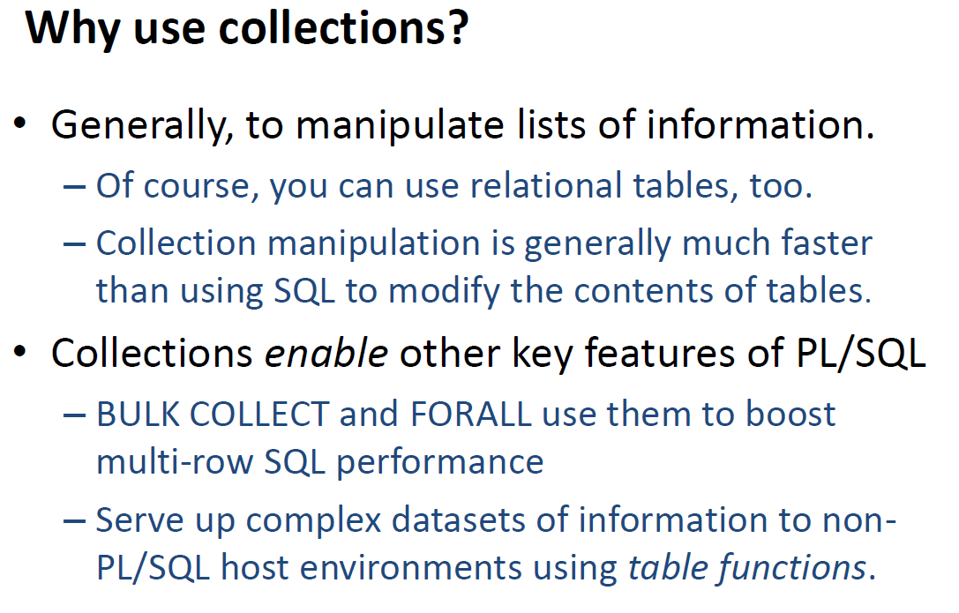

Slide 24
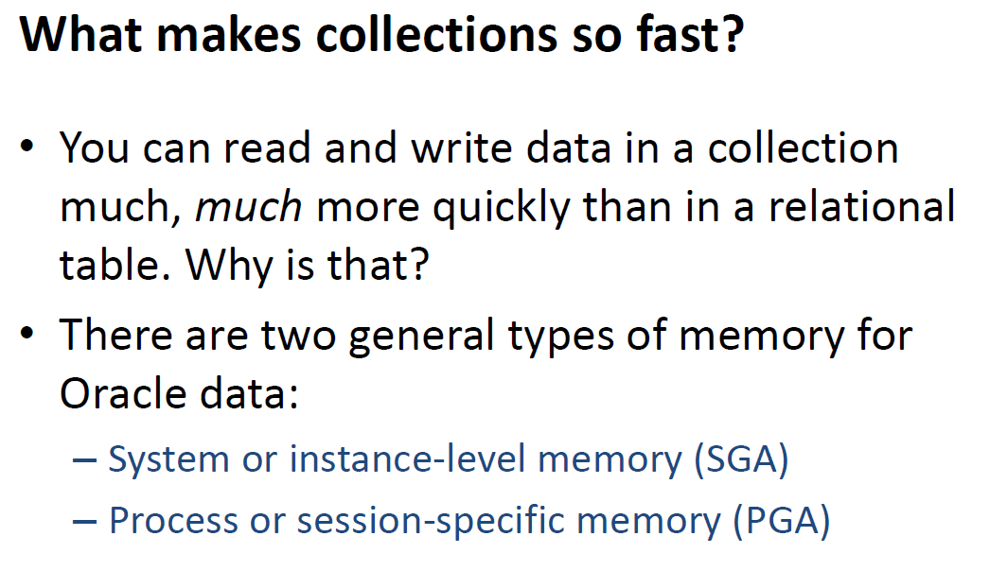

Slide 25
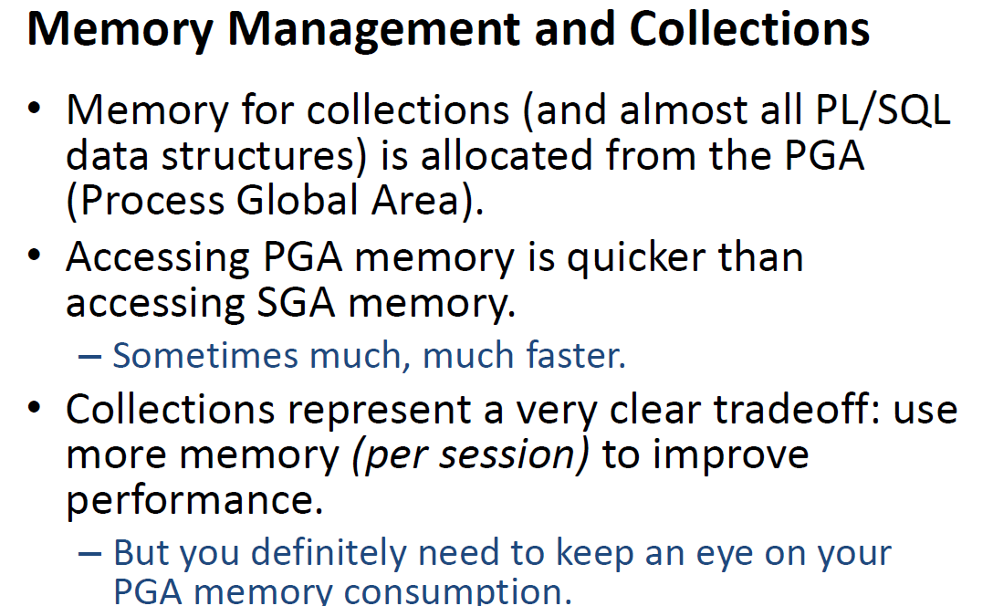

Slide 26
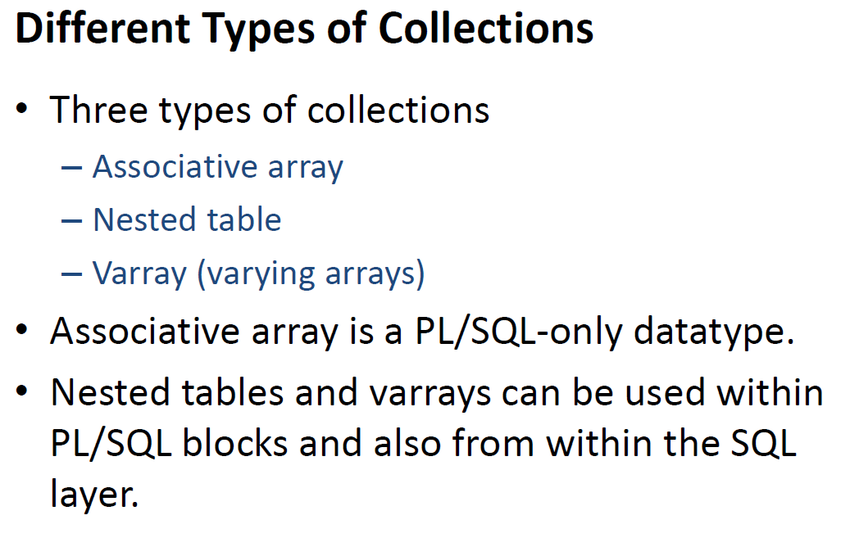

Slide 27
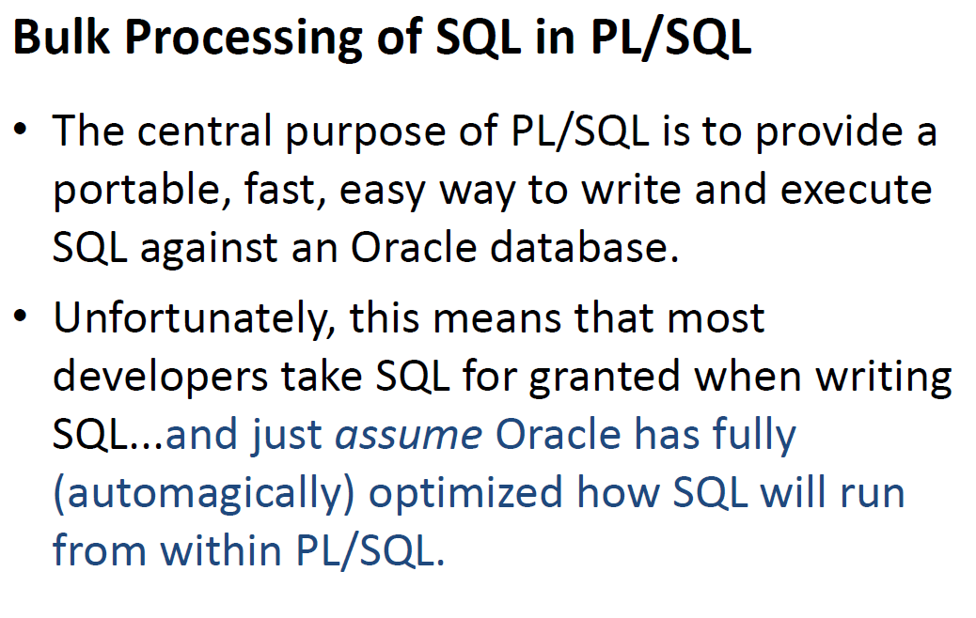

Slide 28
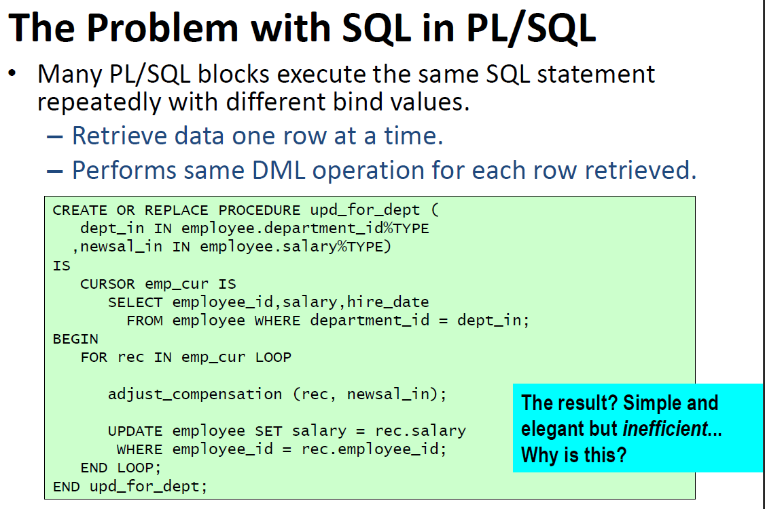

Slide 29
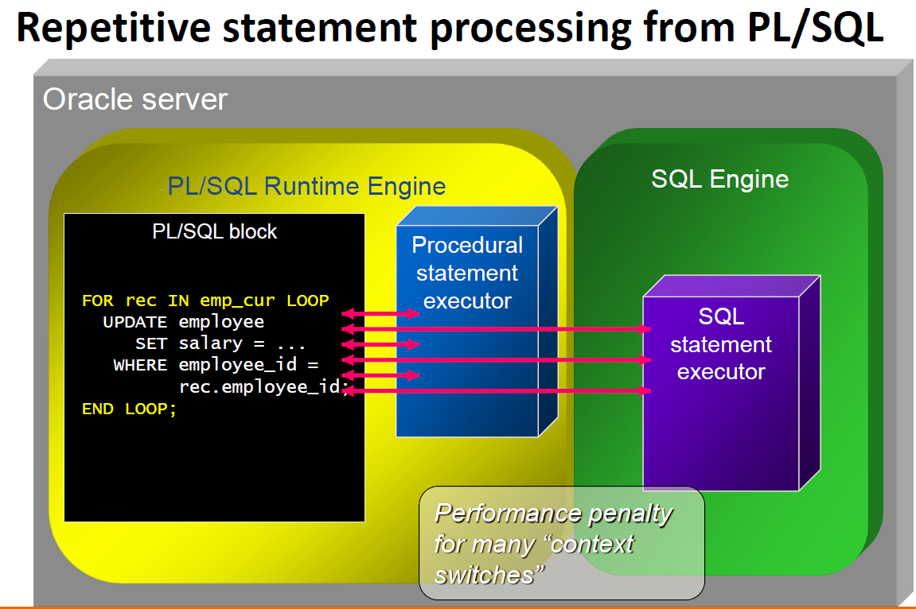

Slide 30
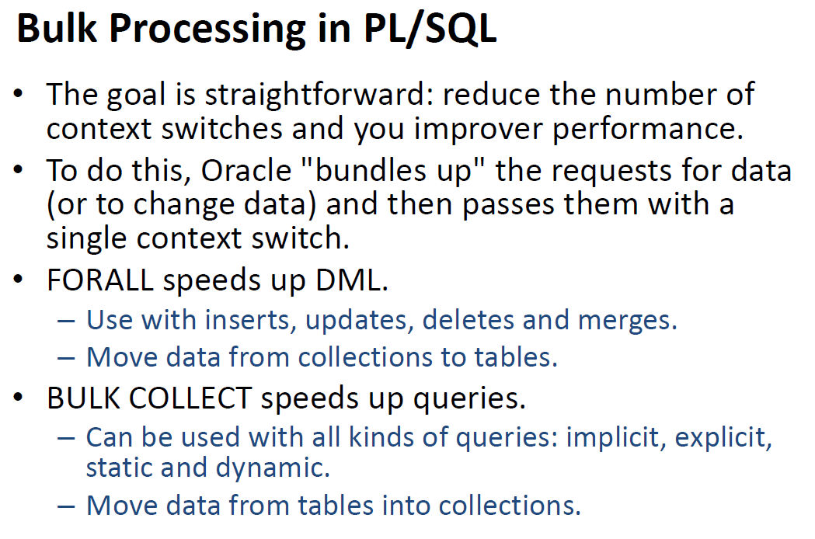

Slide 31
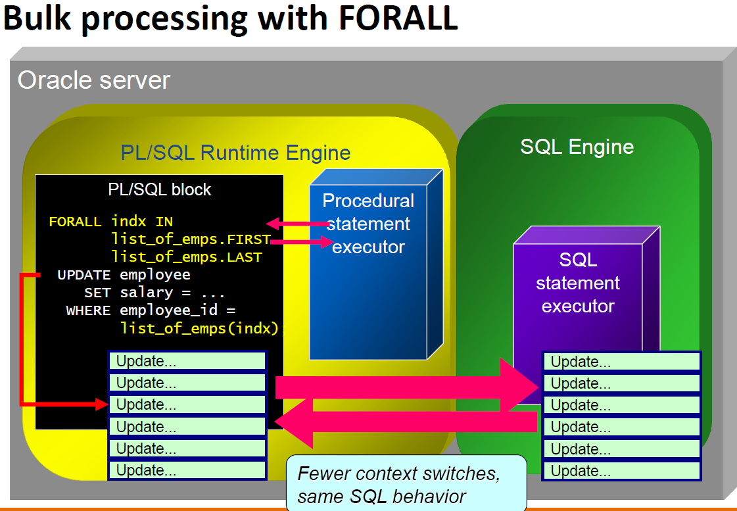

Slide 32
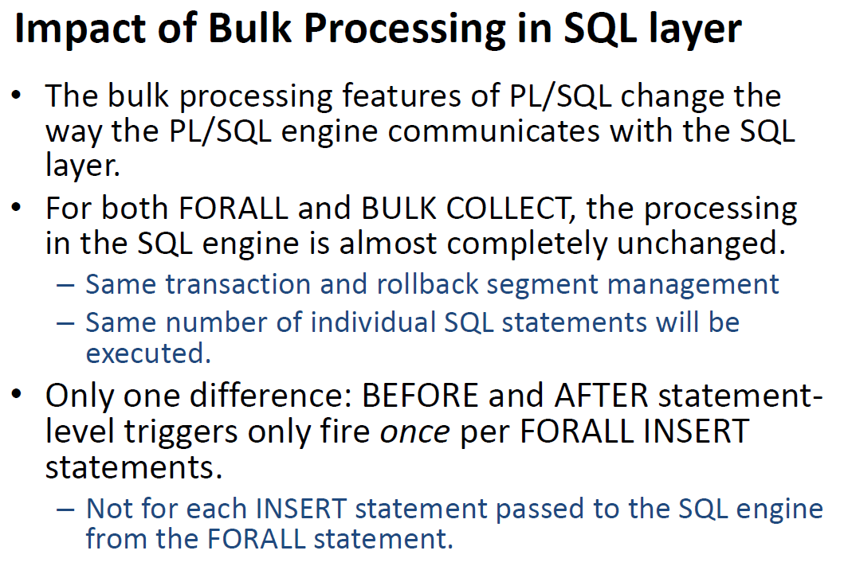

Slide 33
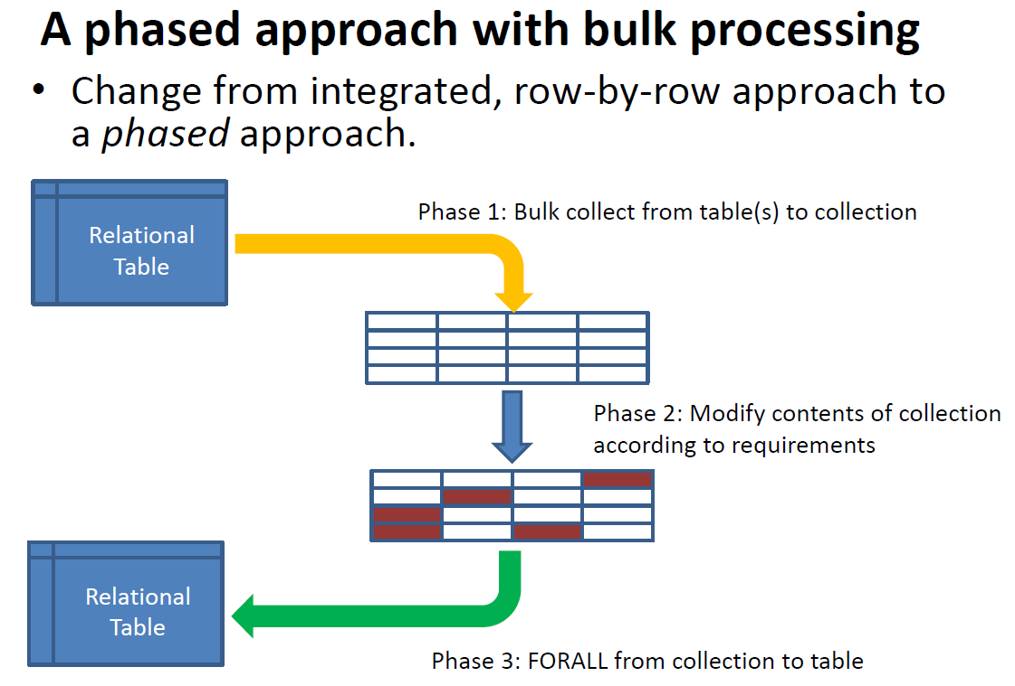

Slide 34
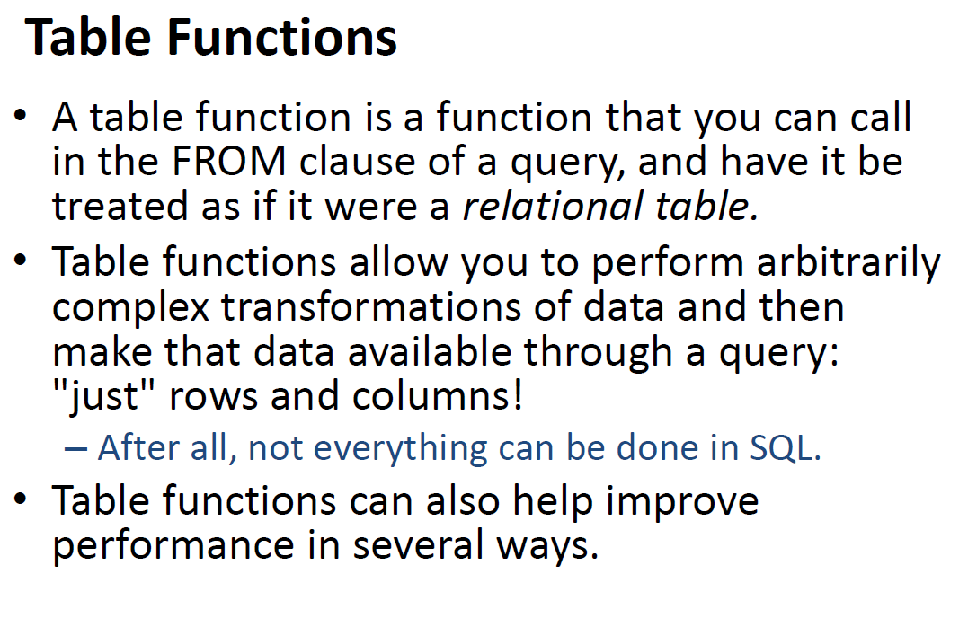

Slide 35
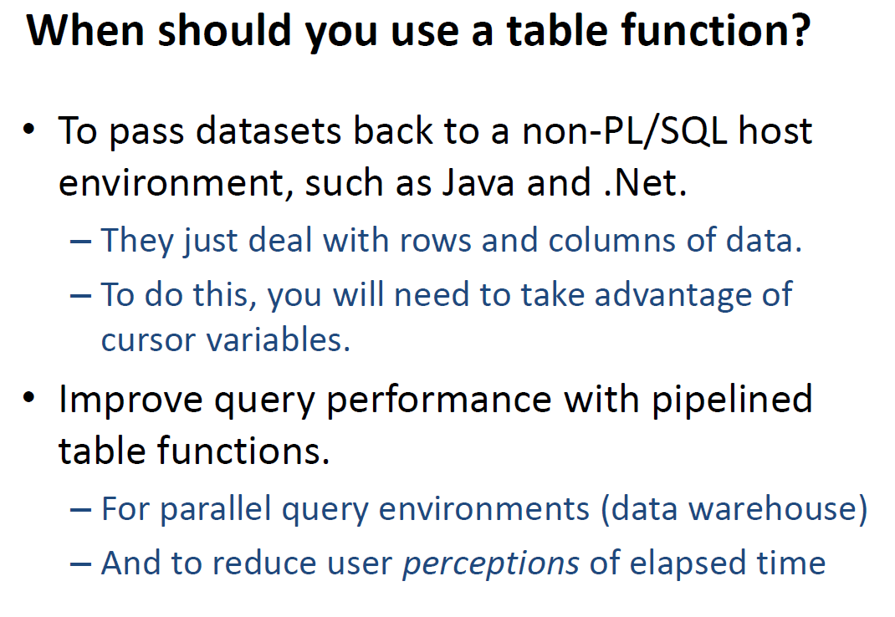

Slide 36
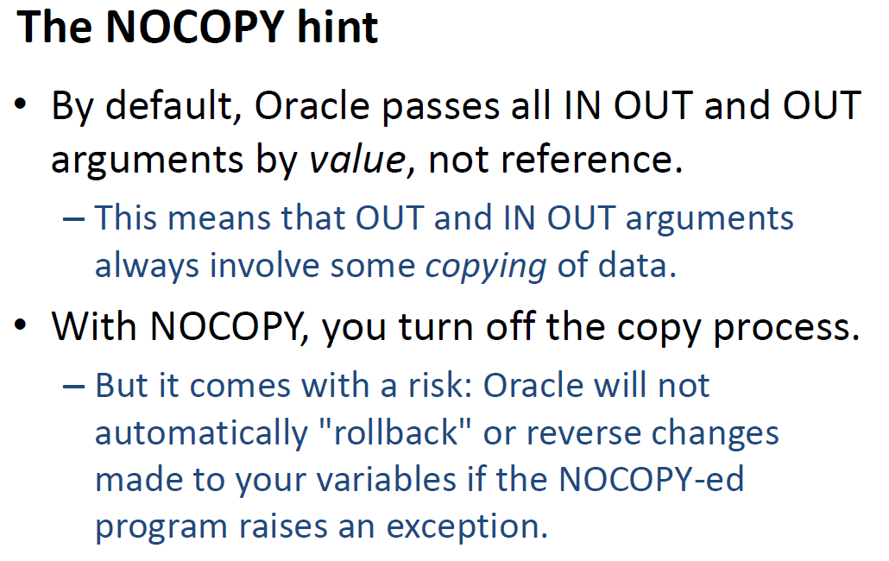

Slide 37
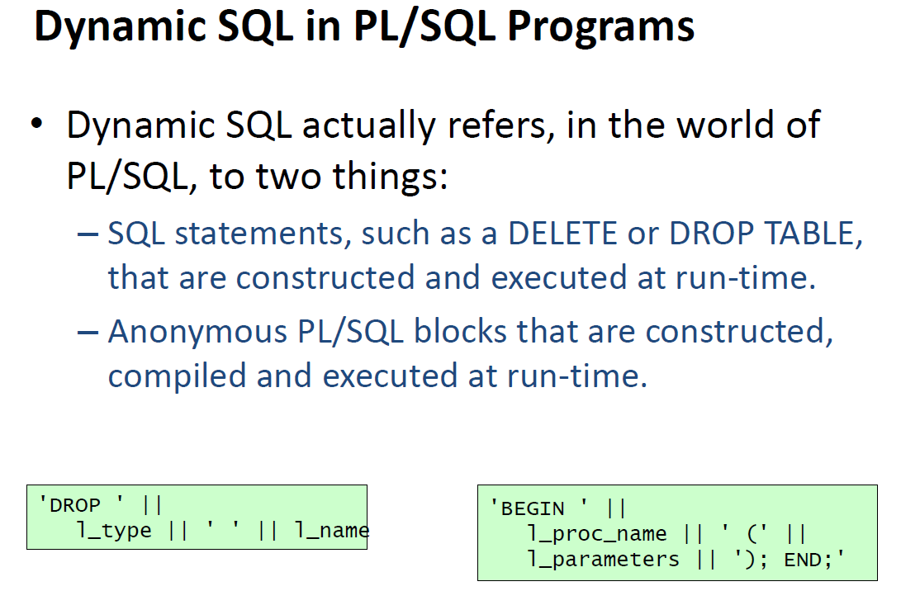

Slide 38
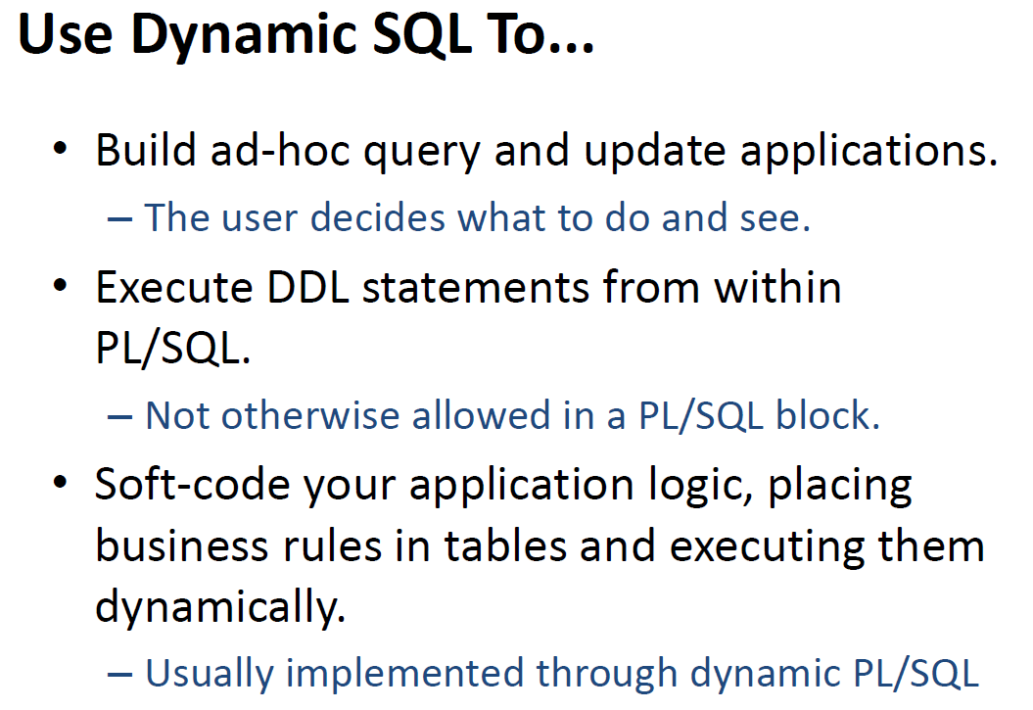

Slide 39
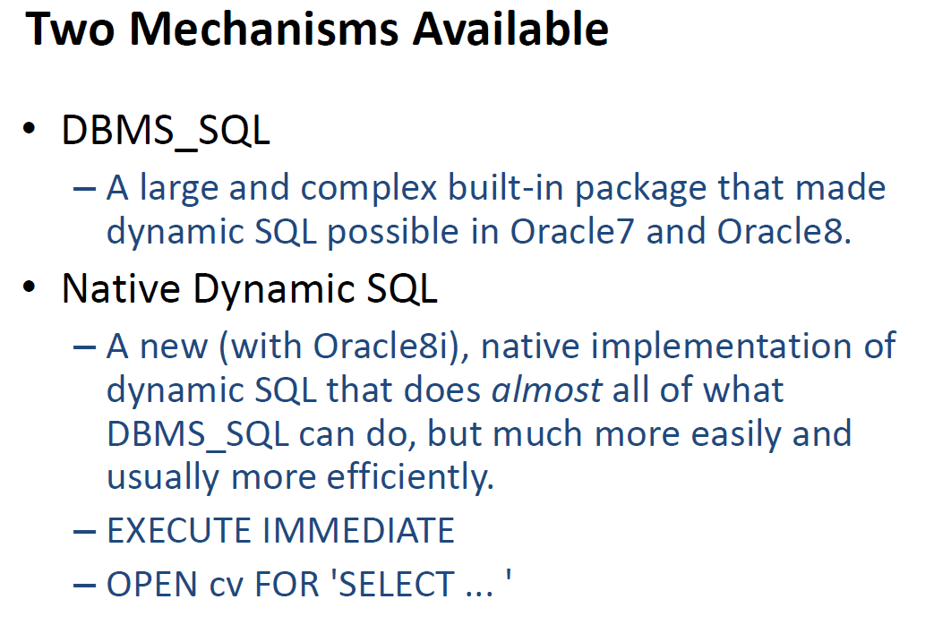

Slide 40
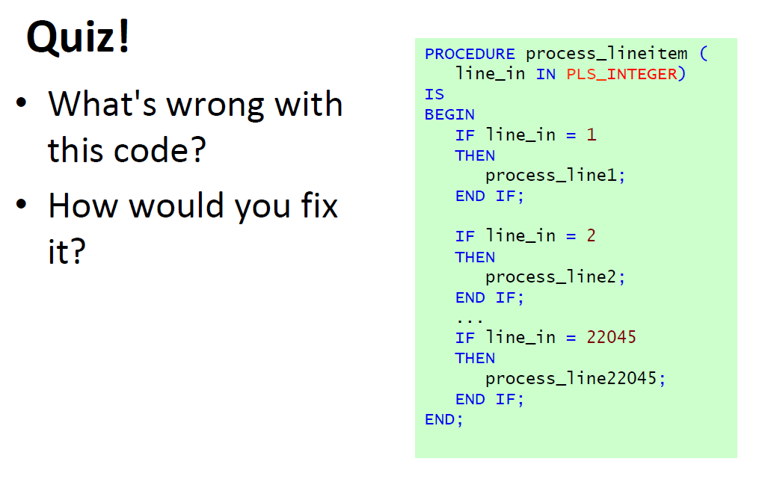

Slide 41
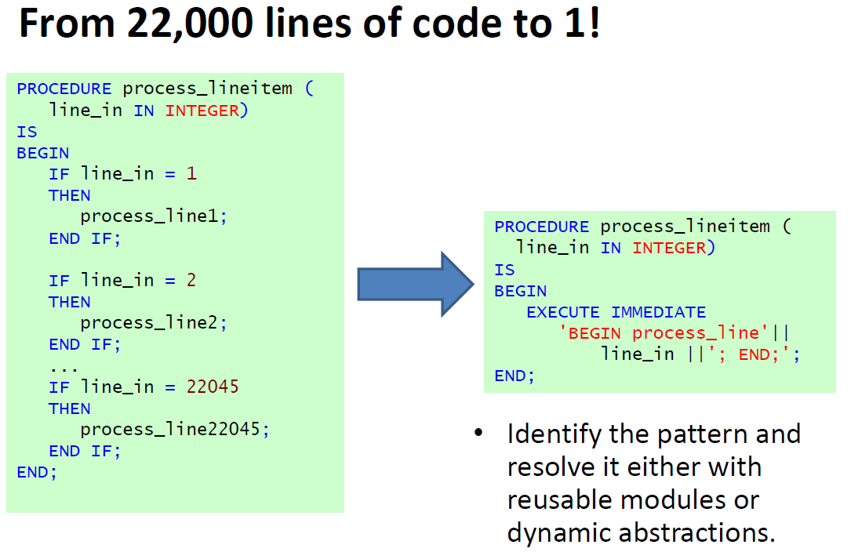

Slide 42
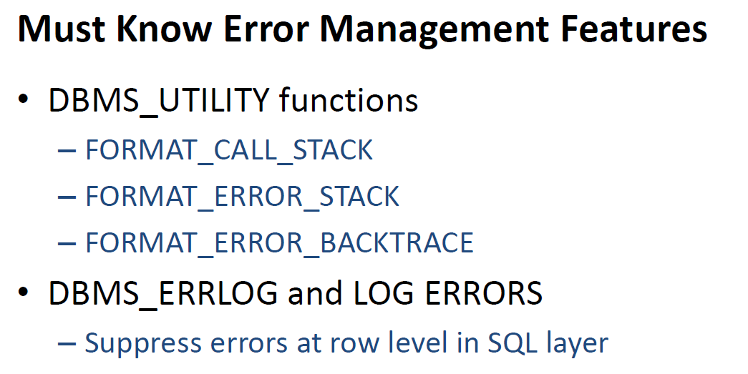

Slide 43
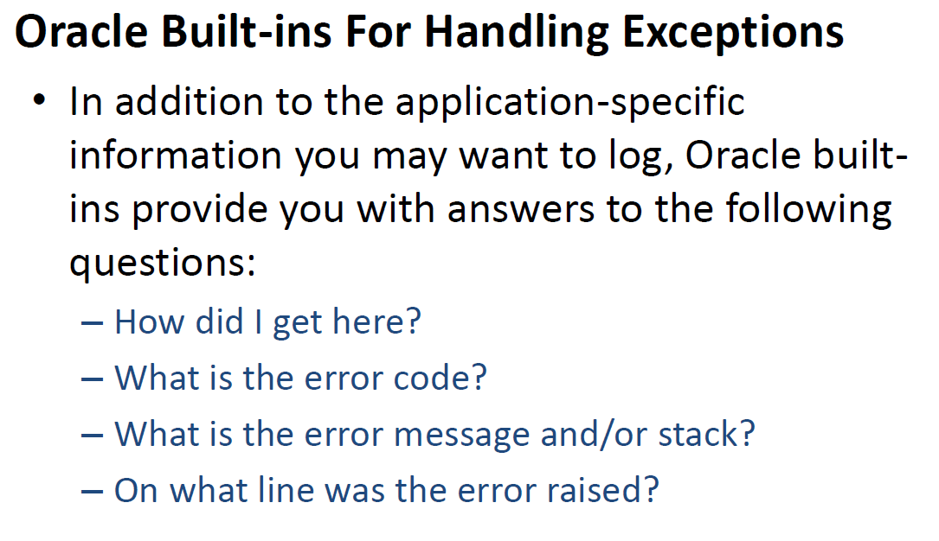

Slide 44
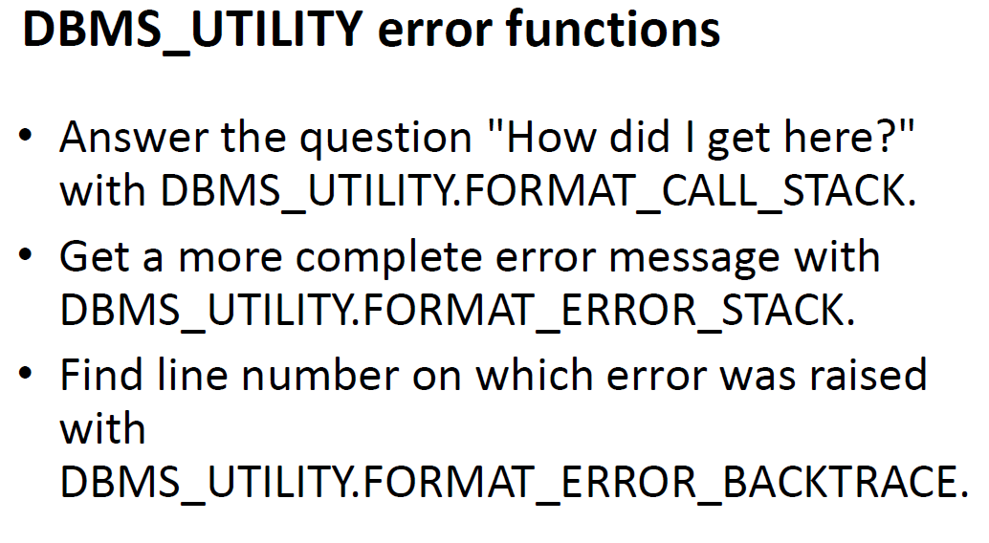

Slide 45
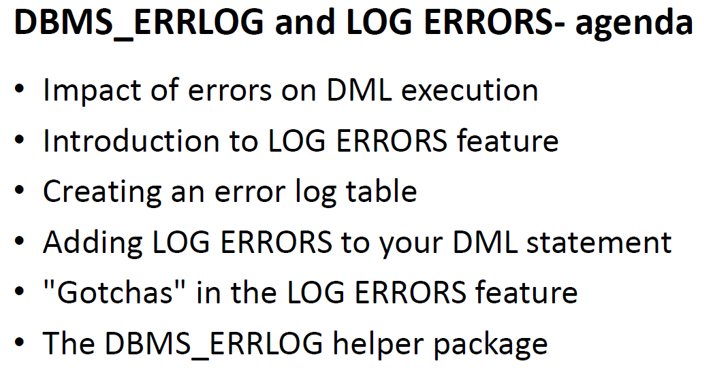

Slide 46
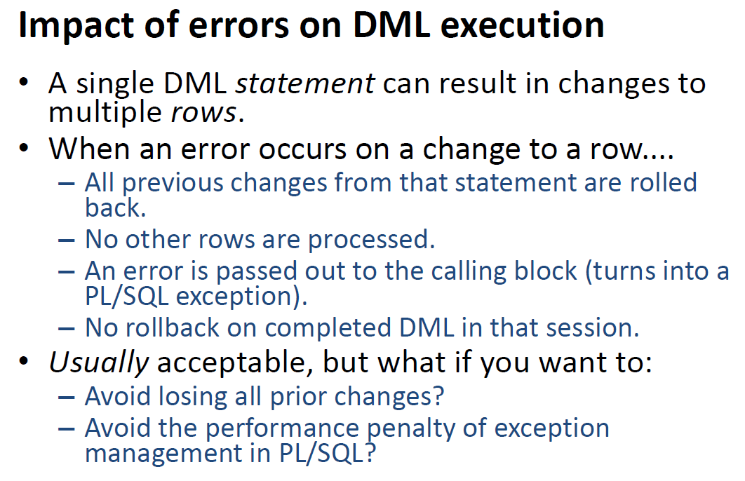

Slide 47
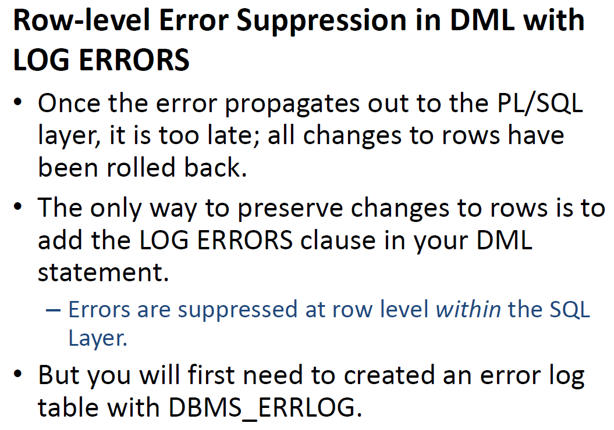

Slide 48
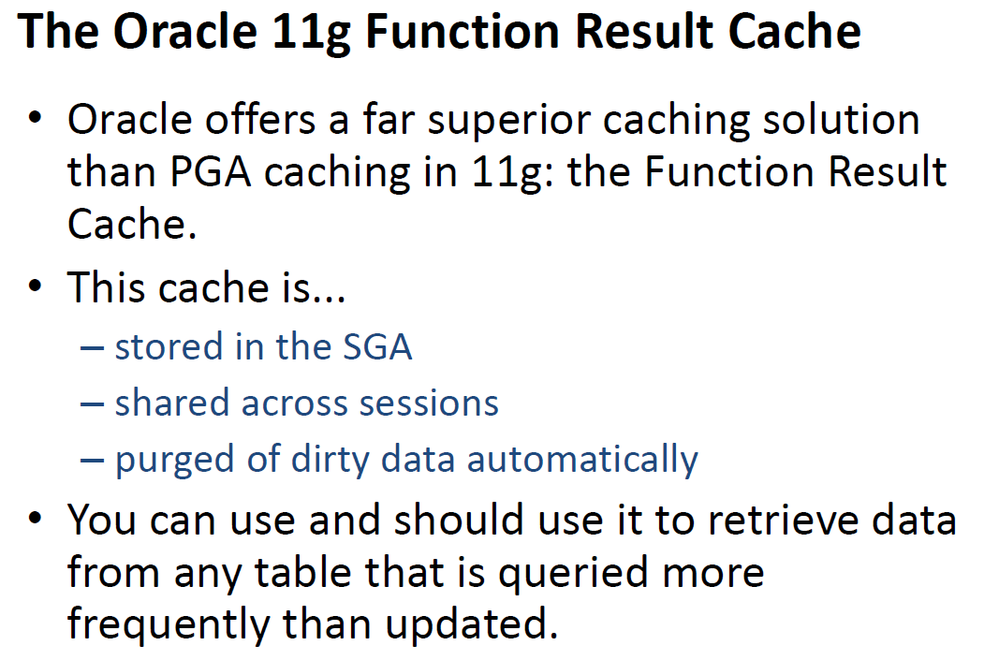

Slide 49
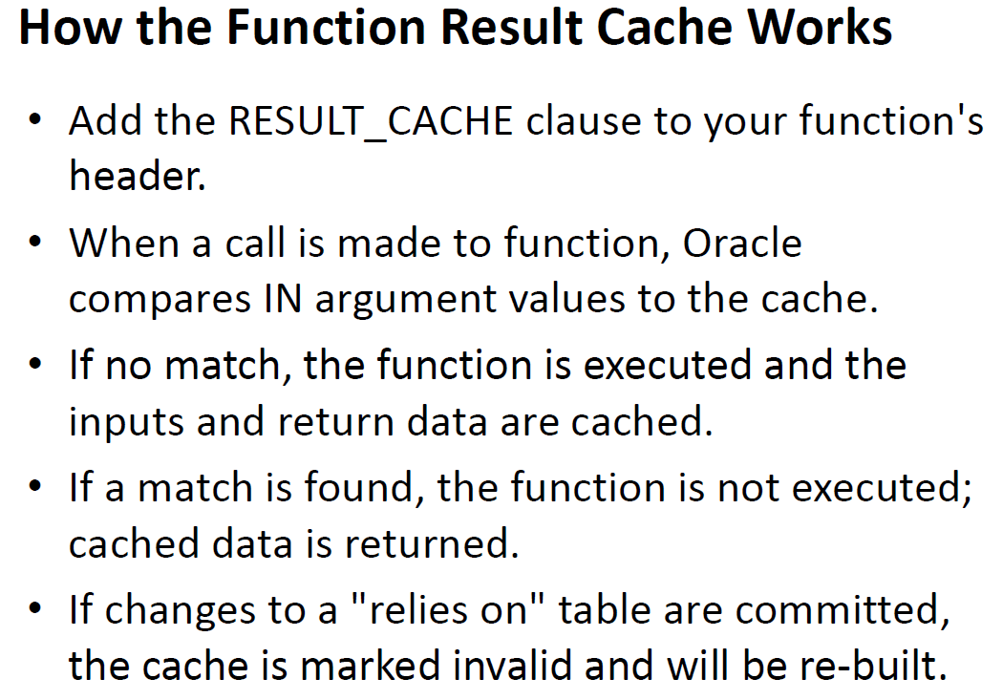

Slide 50
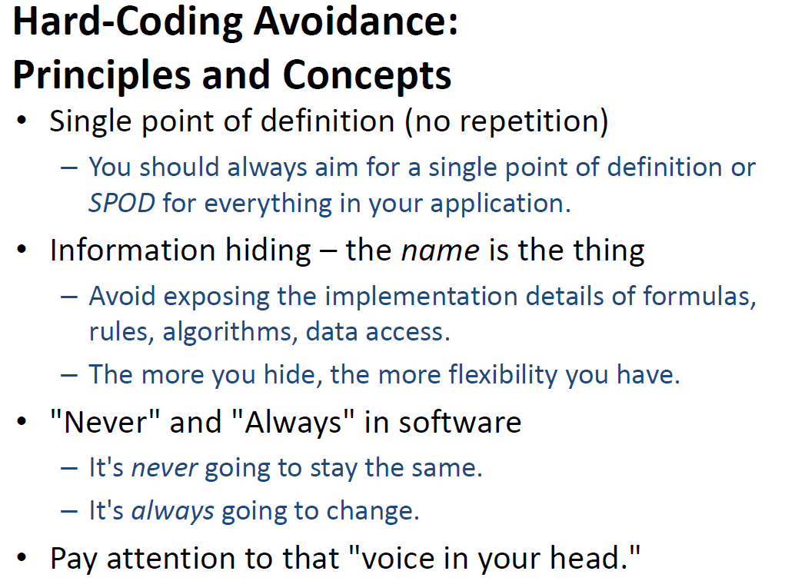

Slide 51
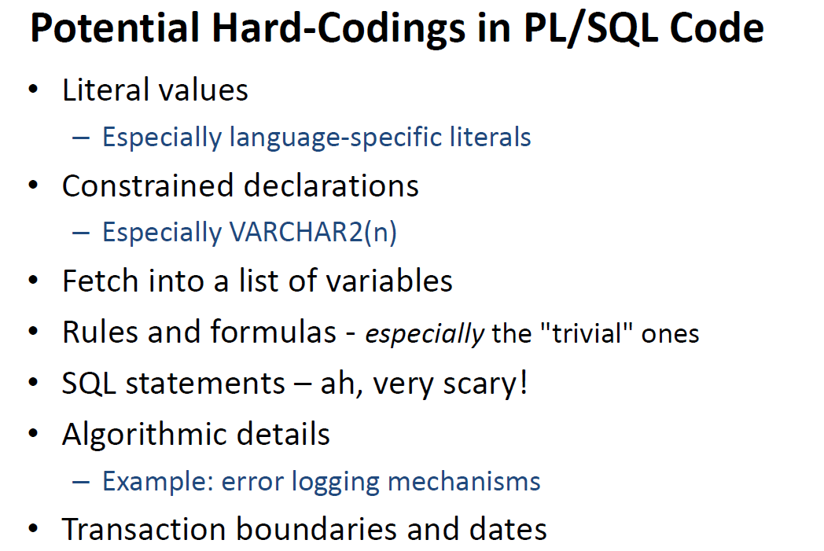

Slide 52
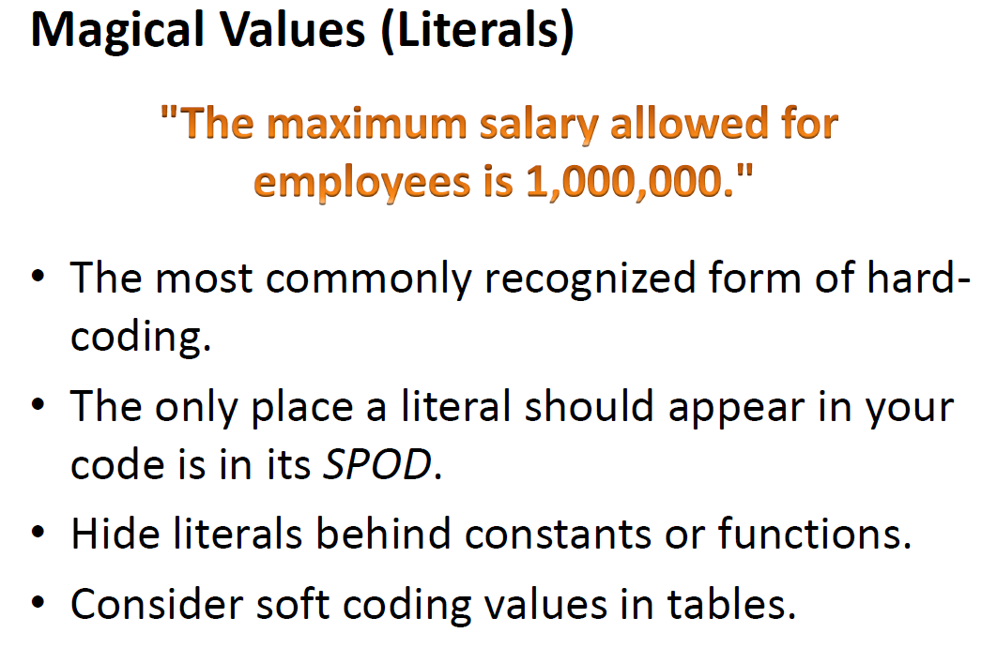

Slide 53
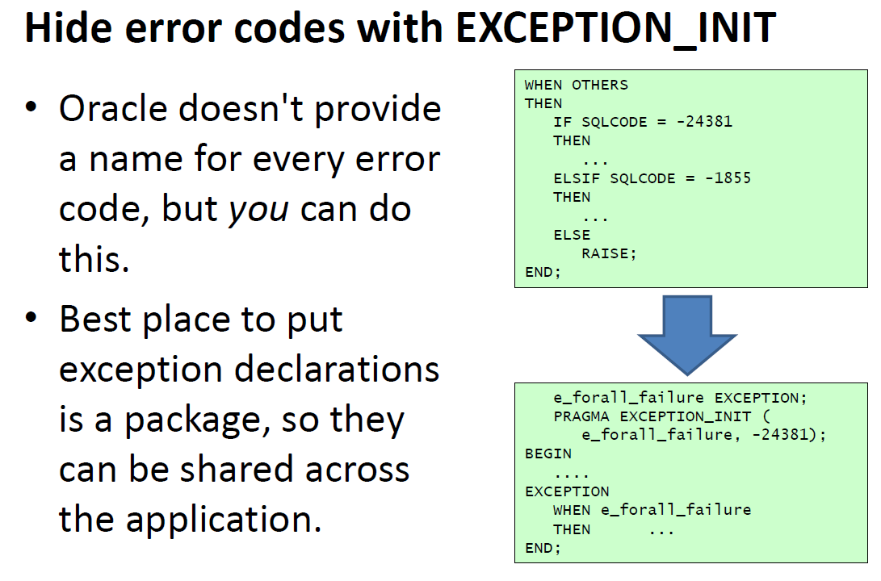

Slide 54
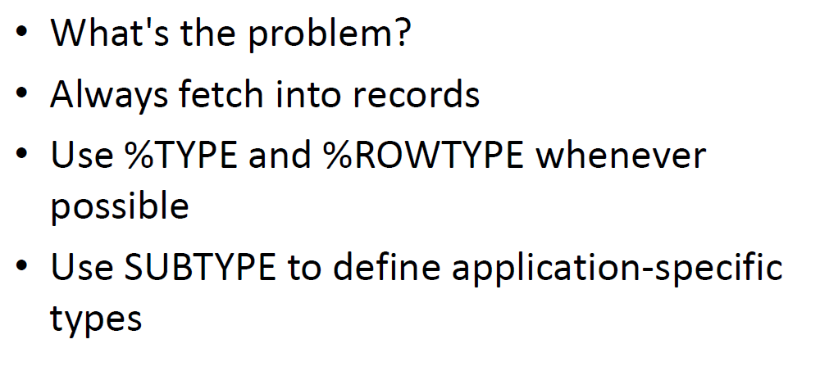

Slide 55
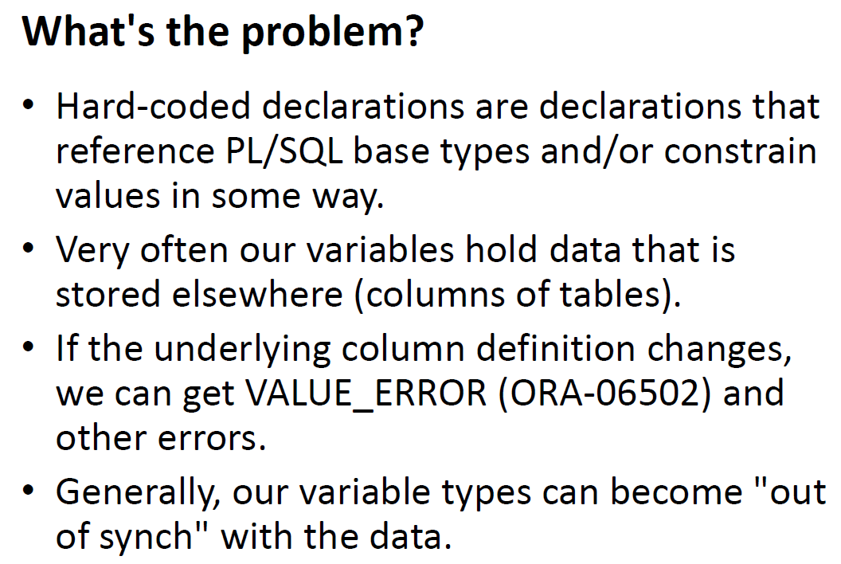

Slide 56
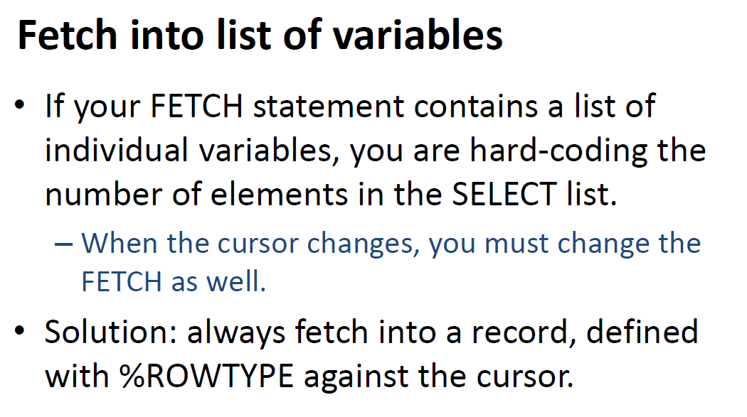

Slide 57
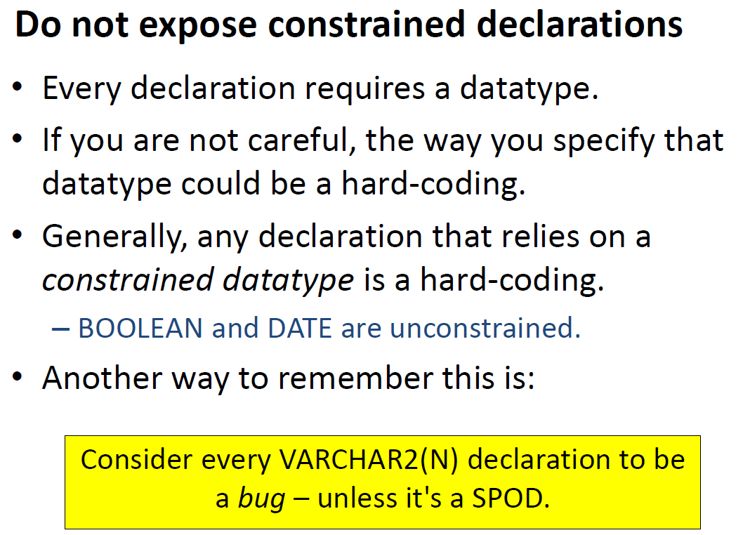

Slide 58
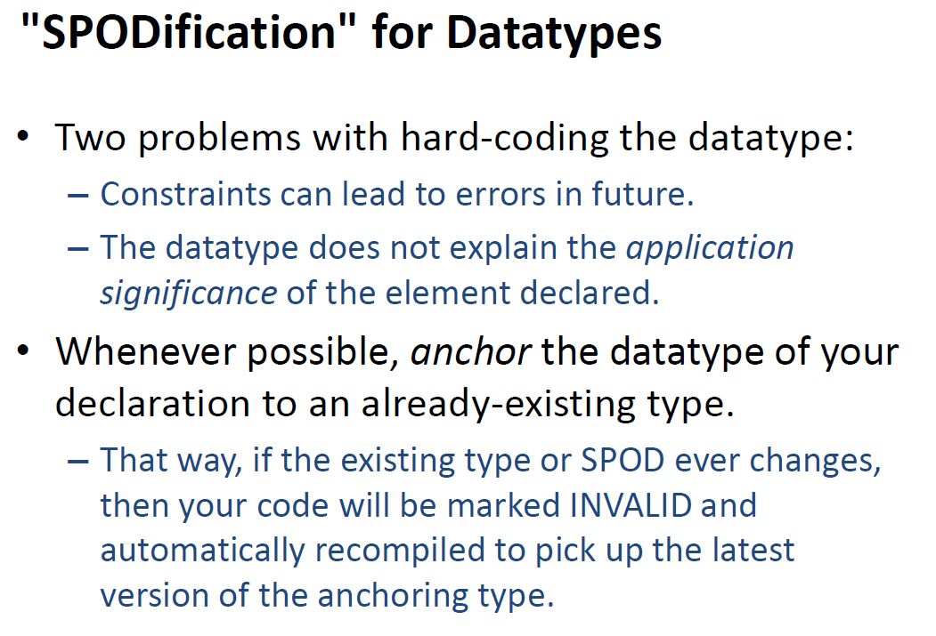

Slide 59


Slide 60


Slide 61


Slide 62



Slide 63


Slide 64


Slide 65


Slide 66


Slide 67


Slide 68


Slide 69


Slide 70


Slide 71


Slide 72


Slide 73


Slide 74


Slide 75


Slide 76


Slide 77


Slide 78


Slide 79


Slide 80


Slide 81


Slide 82


Slide 83


Slide 84


Slide 85


Slide 86


Slide 87


Slide 88


Slide 89
Summary: Do Not Use (PL/SQL Pitfalls)
Row-by-Row Processing

